Slide 1
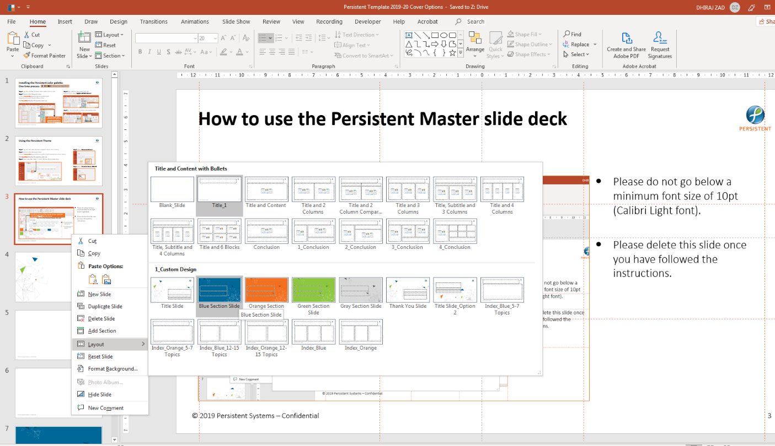
How to use the Persistent Master slide deck
Please do not go below a minimum font size of 10pt (Calibri Light font).
Please delete this slide once you have followed the instructions.
In order to access all the layouts, please right click
and select Layout from the menu.

